Slide 1

Modes of collaboration

Slide 2
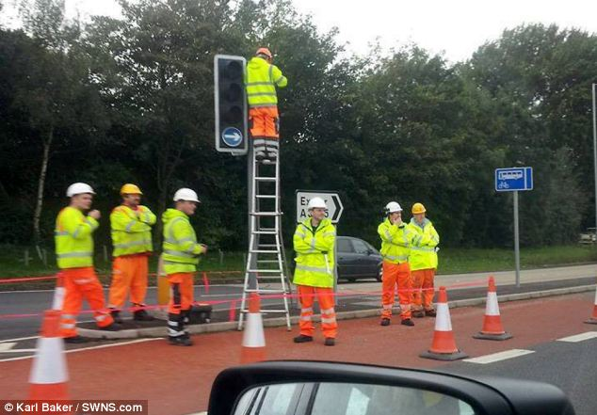
Is this productive?

Slide 3
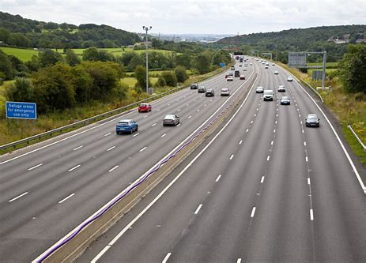

Which leads to higher throughput?

Slide 4
Modes of collaboration
Mob
Group
Pair
Individual

Slide 5
Descriptions and characteristics
Collaboration Type | Description | Throughput (velocity) | Optimal for
Mob | Whole team focused on one thing | Low | Discussing and deciding on something that impacts everyone
Group | 3 to 4 focused on the same thing/ ½ of the team | Slightly better | Discussing something important
Pair | 2 focused on the same thing | Better | Moving a problem forward with the skill of two people. Great for learning/teaching
Individual | 1 person focused on one thing | Better? | Doing things I know how to do

Slide 6
Which leads to higher throughput?

Slide 7
Agile approach
One owner of a story
Smallest group possible working through a problem, challenge or work item
Assume relatively equal level of skill
Using pairing to accelerate learning
Use mobs and group very sparingly

Slide 8
Assignment
Be ready to discuss with your faculty member how you’ll get more work done (from the board) in parallel?
For each individual be ready to talk through from the Kanban board
what I did since last time
what I am planning this time
what are the blockers (if any)

